Slide 1
APOLOGETICS
IN ONE LESSON
almost
Ai1L.net
Lesson 16
With the Gospel, I See the World as It Is

Slide 2
List out some ways in which David Wood lived out his Atheism
1

Slide 3
“I believe in Christianity … because by it I see everything else.”
2

Slide 4
“ Dear Sir, I am. Yours, G.K. Chesterton.”
Essay in response to “what is wrong with the world?”

Slide 5
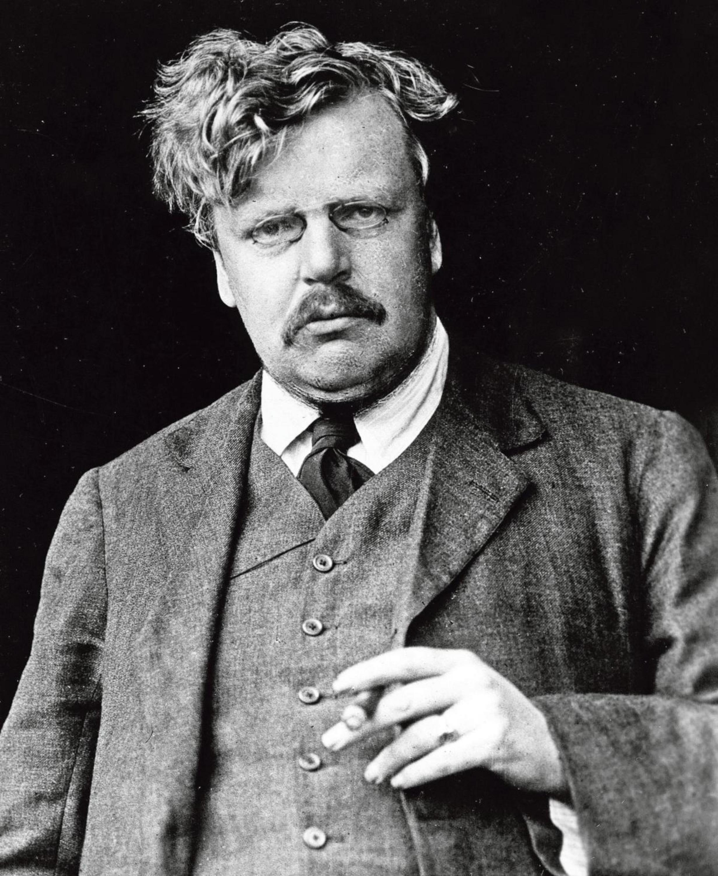
“Dear Sir, I am. Yours, G.K. Chesterton.”
G.K. CHESTERTON Essay in response to “what is wrong with the world?”

Slide 6
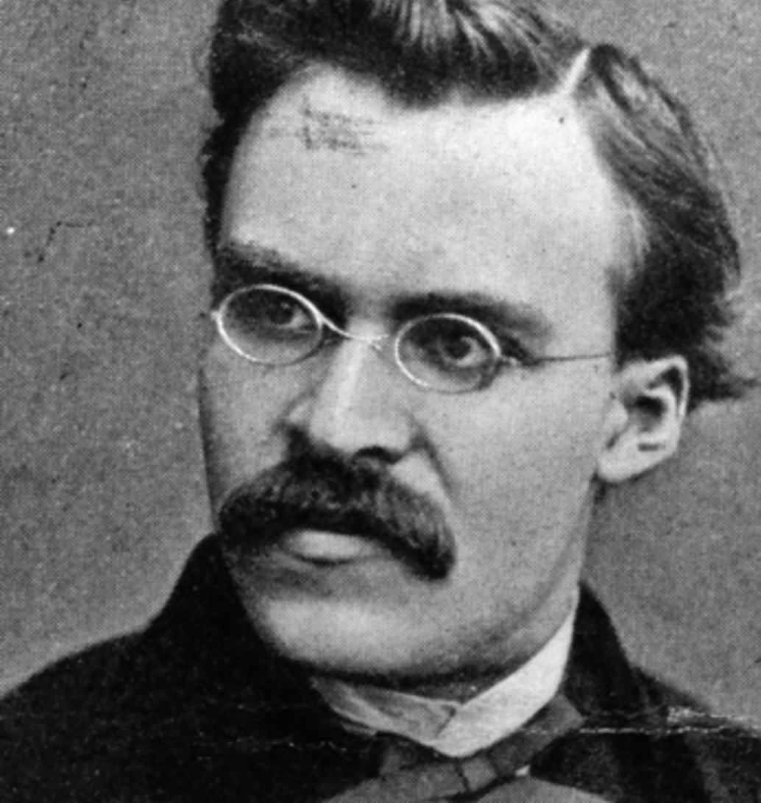
“God is dead. God remains dead. And we have killed him. How shall we comfort ourselves, the murderers of all murderers? What was holiest and mightiest of all that the world has yet owned has bled to death under our knives: who will wipe this blood off us? What water is there for us to clean ourselves?”
“What I relate is the history of the next two centuries. I describe what is coming, what can no longer come differently: the advent of nihilism... For some time now our whole European culture has been moving as toward a catastrophe.”
“When one gives up the Christian faith, one pulls the right to Christian morality out from under one's feet. This morality is by no means self-evident… Christianity is a system, a whole view of things thought out together. By breaking one main concept out of it, the faith in God, one breaks the whole.”
FRIEDRICH NIETZSCHE The Will to Power
FRIEDRICH NIETZSCHE Twilight of the Idols
FRIEDRICH NIETZSCHE Thus Spoke Zarathustra

Slide 7
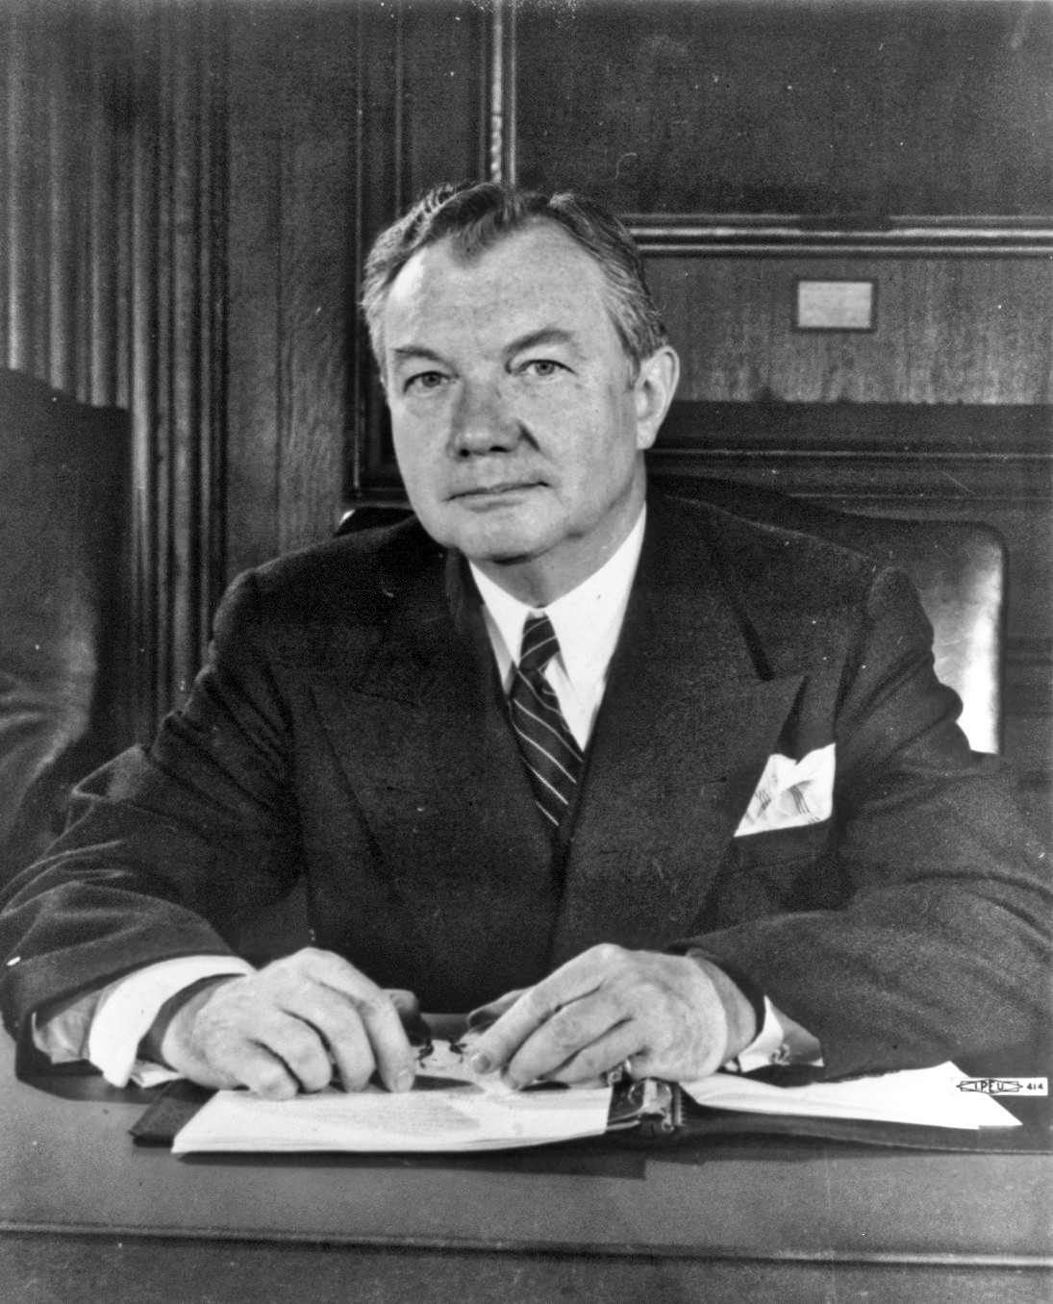
“there is in the tradition and experience which we include under the name of ‘the law’, a wisdom higher than that of any legislature or its statutes and more sure than that of any court or its decisions.”
JUSTICE ROBERT H. JACKSON The Law Above Nations

Slide 8
“No decent person wants to live in a society which works according to Darwinian laws.... A Darwinian society would be a Fascist state ”
RICHARD DAWKINS Die Presse, July 30, 2005, p. viii.

Slide 9
“It is just as absurd to ask strength not to express itself as strength, not to be a desire to overthrow, crush, become master, [not] to be a thirst for enemies, resistance and triumphs, as it is to ask weakness to express itself as strength.”
FRIEDRICH NIETZSCHE On the Genealogy of Morality

Slide 10
“﻿in my junior-year Latin class reading some of the more philosophically despairing poets, and asking my teacher why, if they felt life was meaningless, didn’t they just kill themselves?
My teacher replied, ‘A lot of them did.’”
HOLLY ORDWAY Not God's Type
Notes:
My teacher replied, ‘A lot of them did.’”

Slide 11
“We were made for another world”
3

Slide 12
“﻿Do we have free will? He said ‘no’ writing philosophy; but acted ‘yes’ and wrote ‘yes’ when his moral passions were engaged. Is there progress in the world? He might say ‘no’ and make fun of the sillier versions of it, but he acted ‘yes’ and based his life of hope on it.”
KATHARINE TAIT (DAUGHTER OF BERTRAND RUSSELL) My Father, Bertrand Russell (page 184)

Slide 13
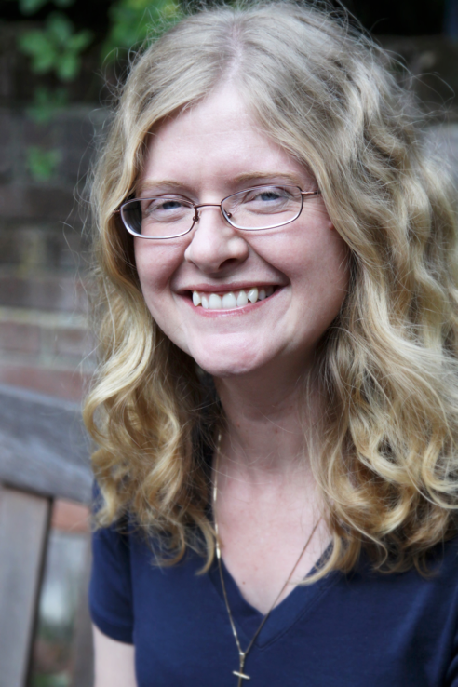
“﻿When I encountered arguments and evidence for Christianity, my reason was finally able to align with my imagination, which, like a compass needle, had tremulously pointed toward true north for many years.”
HOLLY ORDWAY Not God's Type

Slide 14
“Human history… [is] the long terrible story of man trying to find something other than God which will make him happy.”
4

Slide 15
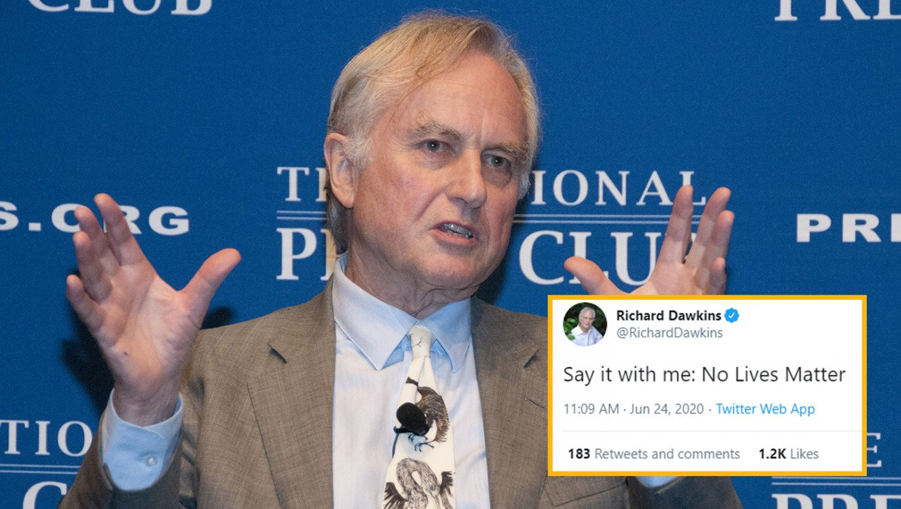
Atheists Launch No Lives Matter Movement
BABYLON BEE, JULY 7TH, 2020

